Slide 1

Chris Woodruff
LearningAbout.Dev
Level: Intermediate, etc.

Slide 2

Identity in your Web API
Learn to Produce Effective Web APIs with ASP.NET 5

Slide 3
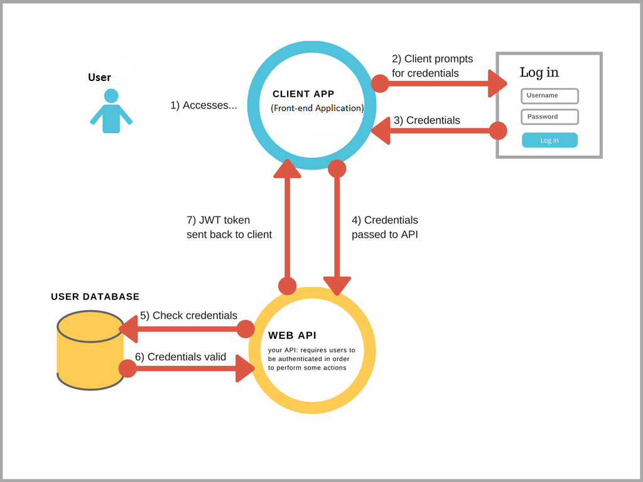
What is happening?

Slide 4
Other ways to provide Identity
Azure Identity and access management (IAM)
ASP.NET Core Identity Provider for Amazon Cognito
Okta and Auth0
IdentityServer 4

